Slide 1
WELCOME
30th Annual
Convention & Trade Show

Slide 2
#NARPM2018

Slide 3
Thank You
Official NARPM Partner

Slide 4
Thank You
Gold Sponsor

Slide 5
NARPM Talks
Business Growth

Slide 6
Company Acquisitions
– What to Expect
Steve Schultz, MPM RMP
Blue Fox Properties LLC, CRMC

Slide 7
Top 5 questions I get regarding acquisitions (from the buyer’s perspective):

Slide 8
1. How much is the company worth?

Slide 9
2. Do I have to look at every property in the portfolio before buying it?

Slide 10
3. What should I look at first to figure out if it’s something I want to buy?

Slide 11
4. How many properties should I expect to lose in the purchase process?

Slide 12
5. How do I make sure I don’t lose the properties once I am managing them?

Slide 13
Go find something to buy!
Good luck!

Slide 14
Networking & Referrals
Make Them Work for You
Jim Roman

Slide 15
Generating Leads Through the Web
Jennifer Stoops, RMP
Park Avenue Properties LLC

Slide 16
How Do You Generate Leads Through The Web? It Is All About The Content, Cadence and Consistency
So how do you know what content to create?
What are the common problems that you hear about that prospective clients are looking to solve?
Develop content around solving potential problems.
Nobody wants what we “sell” they want their problem solved.
Content that addresses awareness…”We know these problems can occur and here is how we can solve that.”
Content that helps build trust.

Slide 17
You’ve Got Your Content…Now What?
What tools do you use to get your content on the web?
Social Media
Facebook - Facebook Live – Facebook Groups
Instagram - Linked IN - Twitter
YouTube – Webinars
What tools can automate Social Media posts?
Hootsuite - HubSpot - Google Analytics – Everypost
What type of content should be posted?
Articles about what problems can be solved
Information about the local economy and market
Local content like upcoming community events or information about things happening at your firm or with your team.

Slide 18
What tools do you use to get your content on the web? (cont.)
Blogging
Use key words pertaining to your business in your blogs (not necessarily words about what we do, but rather words about what we can solve)
Tenant, late rent, eviction, lease, vacancy, maintenance
Use blogs that give potential clients answers to potential problems
We know what the problems are and how to solve them.
What happens when a tenant breaks their lease early
What if a tenant is late on the rent
What happens if you get a squatter
The eviction process

Slide 19
What tools do you use to get your content on the web? (cont.)
Reputation Management
Google, BBB, Facebook
What campaigns can be used to collect review data
New tenant move in / tenant move out process
New owner on-boarding
Maintenance request is completed
Lease renewal execution
What automation tools can be used to solicit reviews?
Birdeye
GatherKudos
Reviewpush
GetFiveStars
GetMoreReviews

Slide 20
What tools do you use to get your content on the web? (cont.)
Your Website
How often do you have a call with your website provider to keep up with the latest trends, check the overall health of your website and update content.
Does your website talk about what you do or what you can solve?

Slide 21
Cadence
A cadence creates a flow of how things should happen, a structure
How often should you be posting content on your site, Social Media, Blogging, Creating reputation management campaigns?

Slide 22
Consistency
Create a plan and make a schedule
Should be posting social media daily, once, twice, weekly, etc
Prepare content and posts in advance for ease of maintain a cadence and schedule
Monitor where your leads are coming from so you know what needs to be altered.
REMEMBER CONTENT, CADENCE AND CONSISTENCEY

Slide 23
Using Video to
Attract Owners
Tony Cline, RMP
Home Vault Property Management

Slide 24
4 hours in 12 minutes
Is video really that important?

Slide 25
Video Options
Good
Vendor created content
Specific
Generic
White Board videos
Better
Company created content
Personal content
No one knows your story better than you and people will identify with you more than someone else.

Slide 26
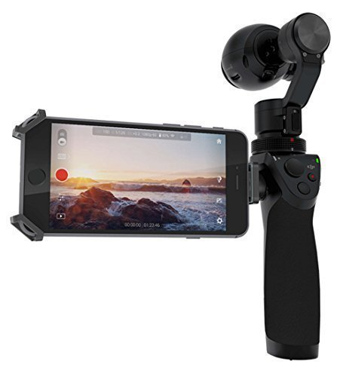
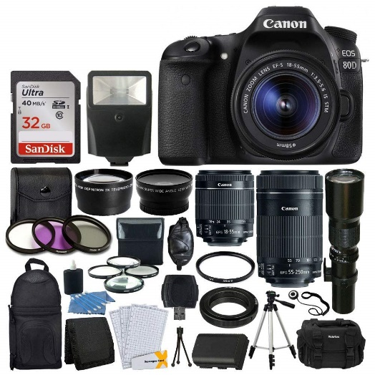
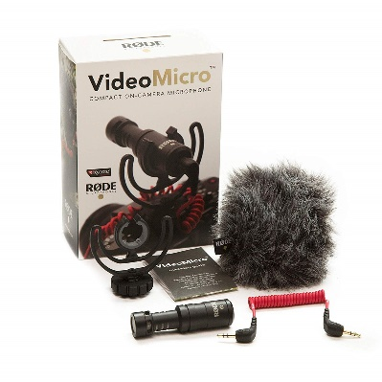
Equipment
Canon 80D
DJI Osmo
Rode Microphone
Lighting kit
Webcam

Slide 27
Learning to drive

Slide 28
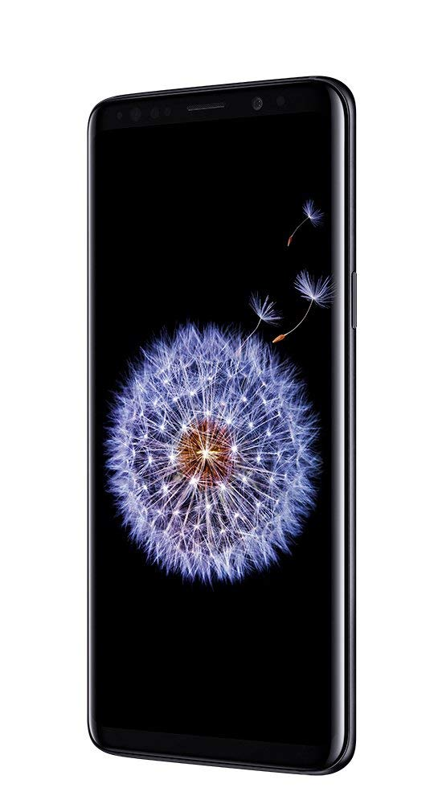
All you really need to get started

Slide 29
Why it doesn’t matter
You don’t like the way you look on Camera
You don’t know what to say

Slide 30
The way you look on Camera
Doesn’t add 10 pounds
Doesn’t make your nose/ears look bigger
Doesn’t make your teeth crooked
Your mental image vs. reality
You think you look robotic

Slide 31
You don’t know what to say
You do know what to say
You don’t feel natural

Slide 32
Content
How not to do video

Slide 33
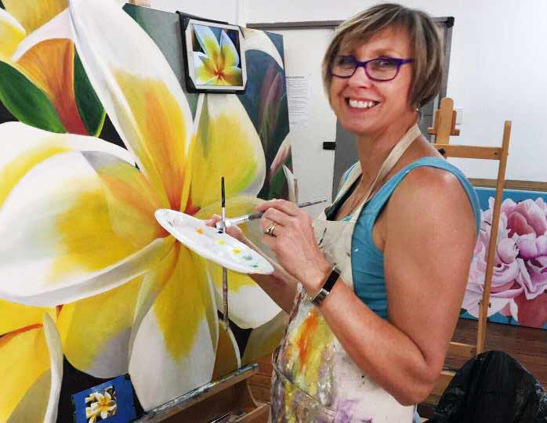
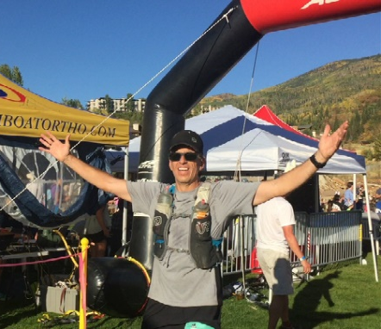
Content
How to do video

Slide 34
Where to use video
Youtube
Facebook personal page
Facebook company page
Company website
Client prospects
Client onboarding & ongoing communication

Slide 35
The Challenge:
30 videos in 30 days
The content doesn’t matter
Get comfortable in front of the camera
Make a video on your personal page
Hobbies
Family
Anything that interests you that you can get excited about

Slide 36
The Challenge:
30 videos in 30 days
At least 5 of the 30 should be business related to start letting people know what you do, why you do it, and to stay top of mind.

Slide 37
The Challenge:
Send me a friend request:
Tony Cline
Record your video
Post with #NARPM30in30 hashtag
tag me in the comments
Start Today!

Slide 38
Bonus Material
After posting your 30th video using the hashtag #NARPM30in30 ask me for the bonus material:
“52 Videos Every
PM Company should have”

Slide 39
4 hours in 12 minutes
Start now
Be yourself
Friend request me – Tony Cline
Use the hashtag #NARPM30in30
Get the bonus material

Slide 40
Thank You
Official NARPM Partner

Slide 41
Thank You
Gold Sponsor

Slide 43
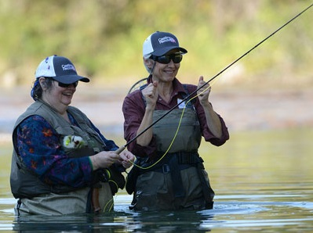
2018 Past Presidents’ Charity Fundraiser

Slide 44
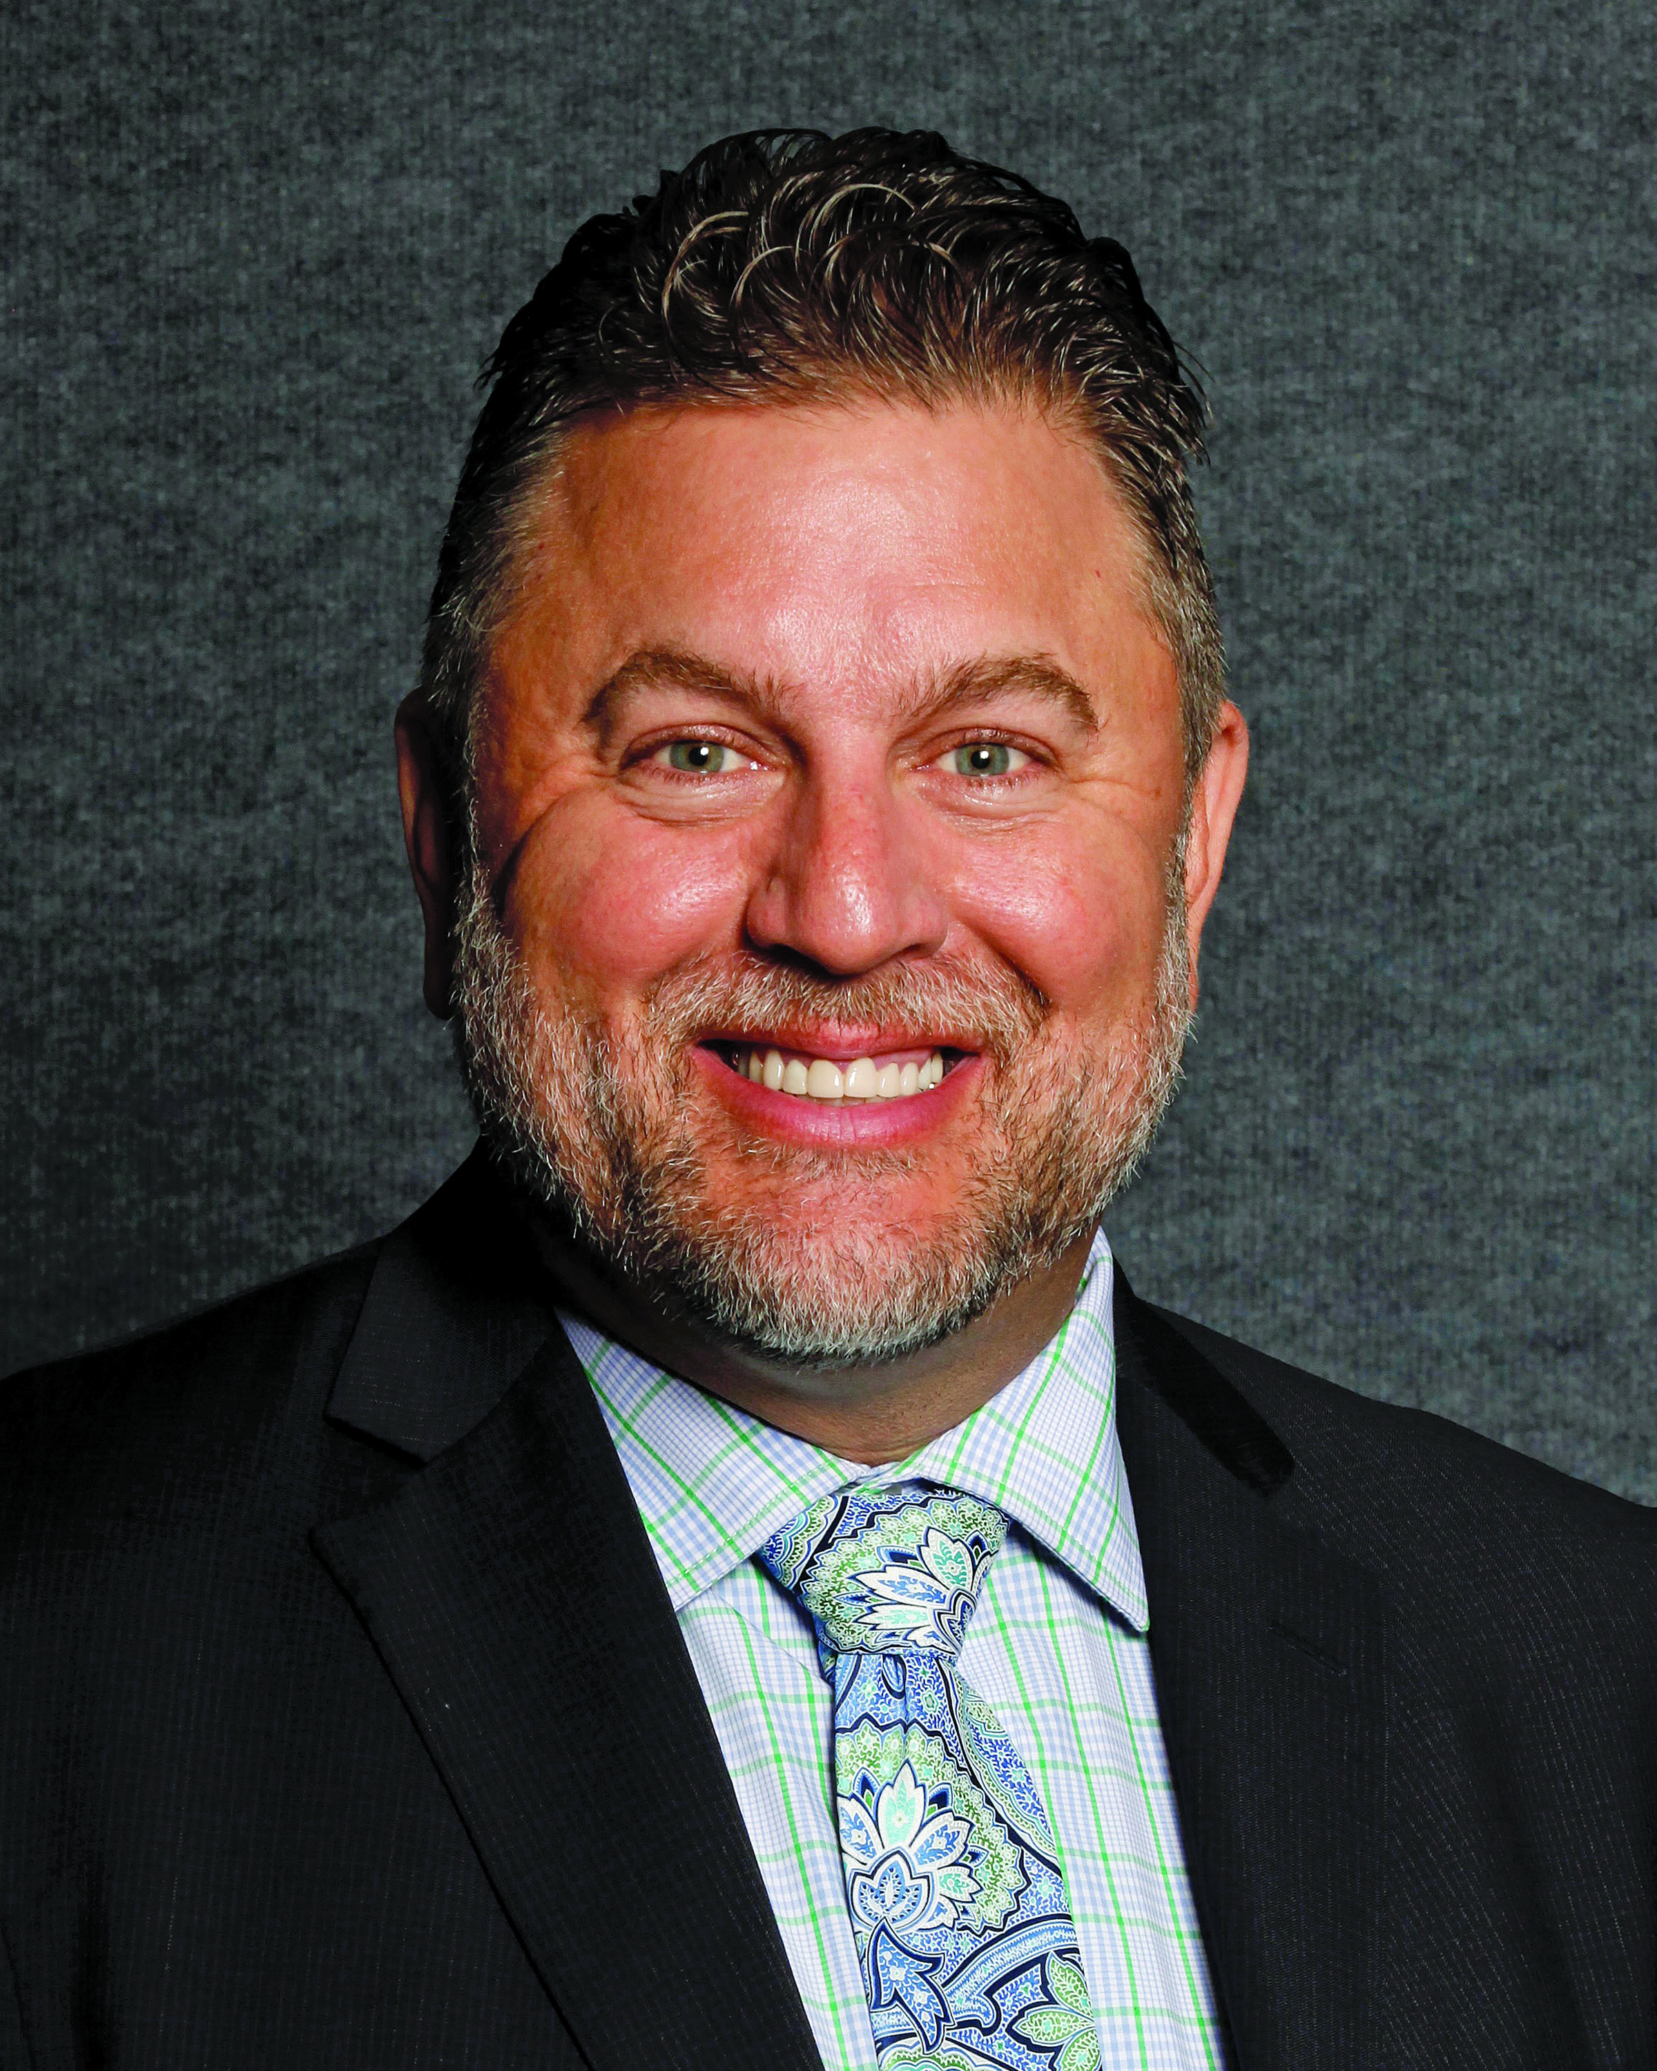
2018
NARPM President
Brian Birdy
MPM RMP

Slide 45
Chapter Excellence
Congratulations

Slide 46
State Chapter of the Year

Slide 48
Large Chapter of the Year

Slide 50
Medium Chapter of the Year

Slide 52
Small Chapter of the Year

Slide 54
30th Annual NARPM
Convention & Trade Show

Slide 55
Member Awards
Congratulations

Slide 56
Congratulations
5 Years

Slide 57
Congratulations
10 Years

Slide 58
Congratulations
15 Years

Slide 59
Congratulations
20 Years

Slide 60
Congratulations
25 Years
Sally Backus, MPM RMP
Eddie Davis, MPM RMP
Stephen Foster, MPM RMP
Debbi Hart, RMP
Christopher Hermanski, MPM RMP
Hank Holland
Robert Locke, MPM RMP
Susan E. Melton, MPM RMP
Joyce C. Moody, RMP
Elizabeth Morgan, MPM RMP
John P. Murphy, Jr.
Scott Porter, MPM RMP
Melissa Prandi, MPM RMP
Rick L. Raich, RMP
David M. Roth
Bonnye L. Sirk, MPM RMP
Daniel C. Thomas
T.J. Tompkins
Cindy Van Mater, MPM RMP
Harry D. Van Mater, MPM RMP
Marshia Webb, RMP
Ted White, MPM RMP

Slide 61
Congratulations
30 Years
Beverly Browning, MPM RMP
Karen Ebert, MPM RMP
John Pariza
Steve Urie, MPM RMP

Slide 62
New Members
Welcome to NARPM

Slide 63
Thank You
Member Services Committee
Bryan Jenkins, MPM RMP
Chair
Angela Holman, MPM RMP
Vice Chair
Jerry Allred, MPM RMP
Liz Cleyman, RMP
Shannon Cornell, RMP
David Dobbins
Robin Frank
Pete Howlett, RMP
Mark Kallus
Sally Knight, RMP
Alan Lam, RMP
Krystal Perkins
Sherri Mayes, MPM RMP
Katie McNeeley
Dawn Ostovich, MPM RMP
Paige Sweeney
Sarah Turocy, RMP
Gail Phillips, NARMP Staff
Jackie Sabogal, NARPM Staff

Slide 64
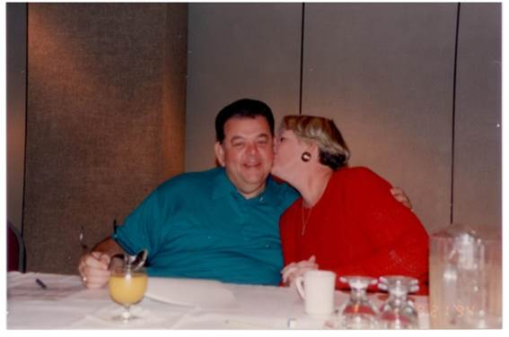
2018 Rocky Maxwell Award

Slide 65
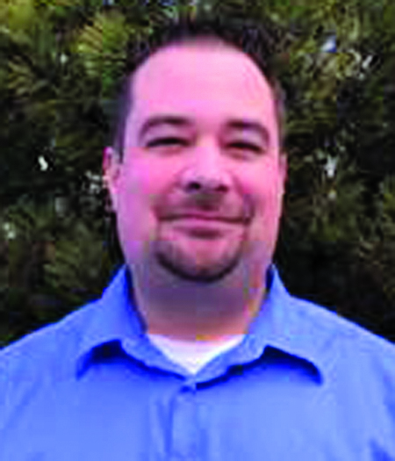
2018 Rocky Maxwell Award
WINNER
Jim Sharone

Slide 66
NEW MEMBER
RECRUITMENT CAMPAIGN
7,500 Members by 2020

Slide 67
30th Annual NARPM
Convention & Trade Show

Slide 68
Affiliates of the Year

Slide 69
Congratulations

Slide 70
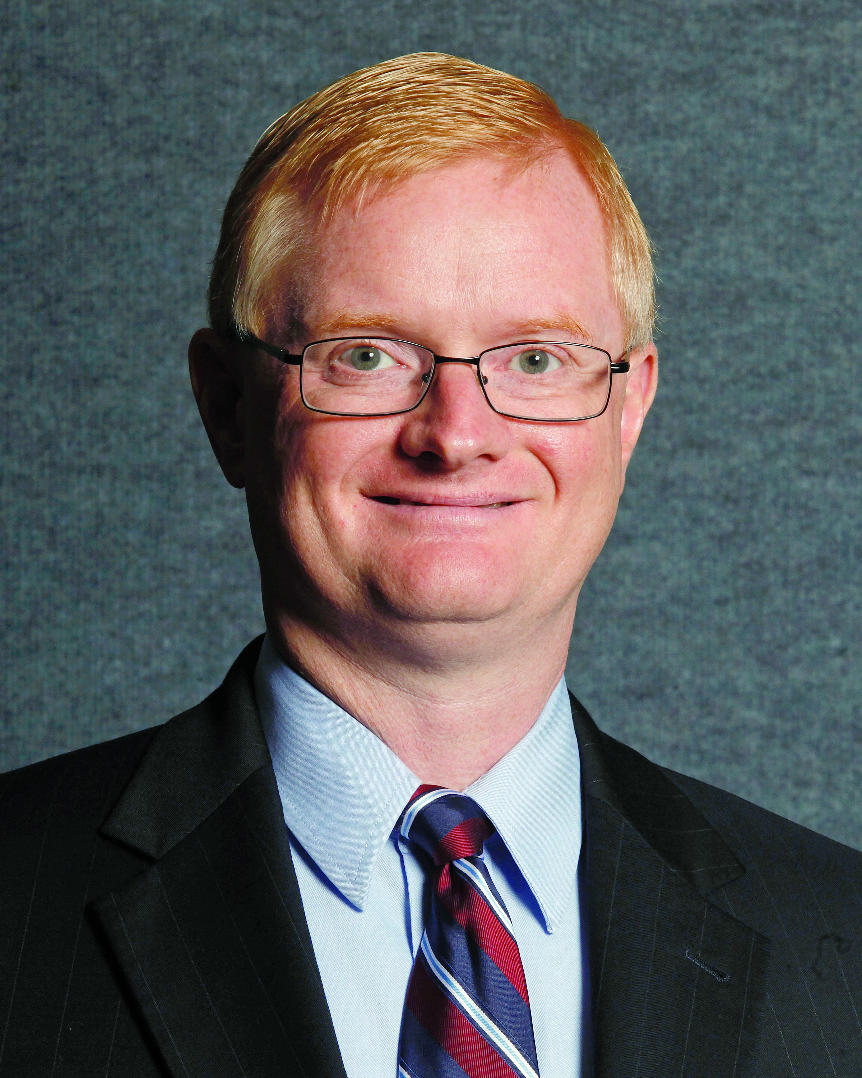
2019
NARPM President
Eric Wetherington
MPM RMP

Slide 71
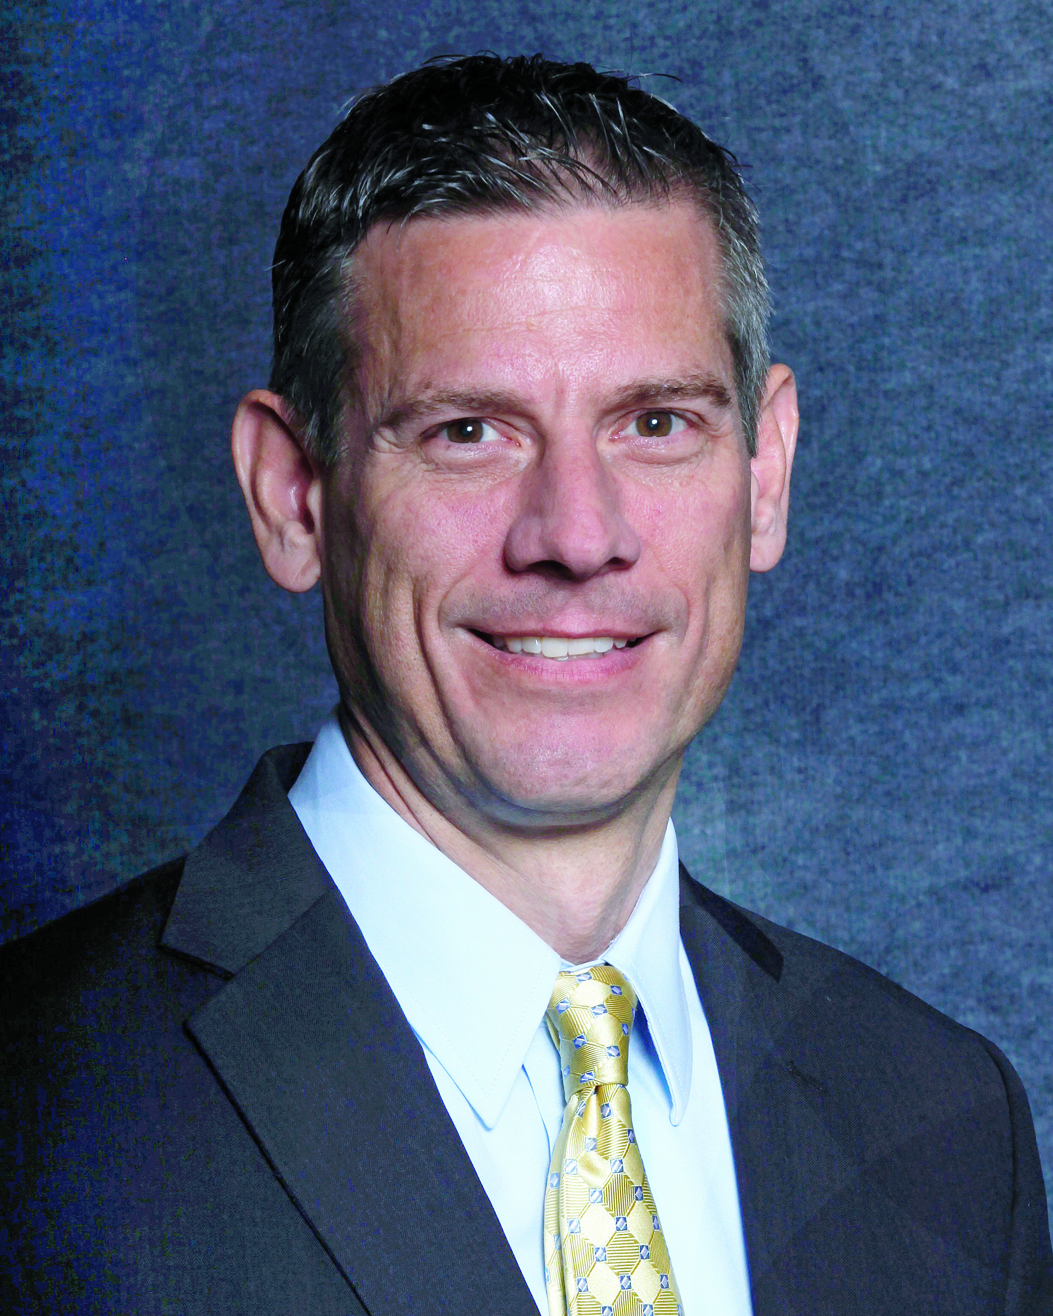
NARPM
Past President
Steve Schultz
MPM RMP

Slide 72
2019 Board of Directors
Kellie Tollifson, MPM RMP
President Elect
Scott Abernathy, MPM RMP
Treasurer
Brian Birdy, MPM RMP
Immediate Past President
Joel Elliot, RMP
Southeast RVP
Chrysztyna Rowek, MPM RMP
Northwest RVP
Liz Cleyman, MPM RMP
Southwest RVP
Charlene Minor, MPM RMP
Pacific and Pacific Islands Regions RVP
Pete Neubig, MPM RMP
Central RVP
Tim Wehner, MPM RMP
Atlantic Region RVP

Slide 73
2019
NARPM President
Eric Wetherington
MPM RMP

Slide 74
2018
NARPM President
Brian Birdy
MPM RMP

Slide 75
30th Annual NARPM
Convention & Trade Show

Slide 76
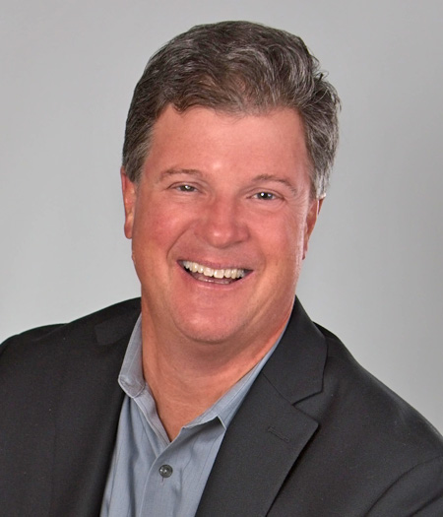
Greg Schwem
Work, Laugh, Repeat

Slide 77
30th Annual NARPM
Convention & Trade Show

Slide 79
30th Annual NARPM
Convention & Trade Show

